Slide 1
Deep Neural Style Transfer
Course Project CS725 Autumn 2019
Guided by Prof. Sunita Sarawagi. Team Members: 16d100018, 16d070064, 18305R002, 184123011

Slide 2
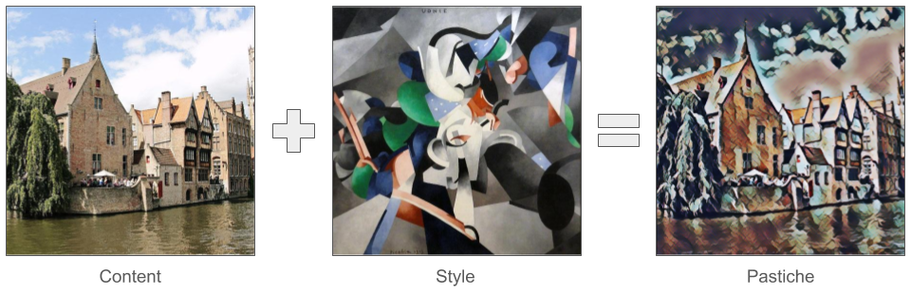
Project Overview

Slide 3
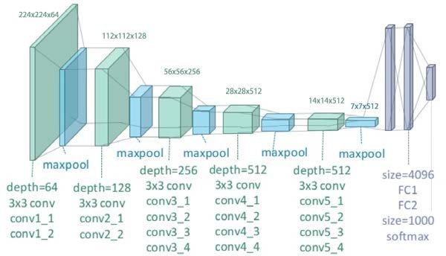
VGG19

Slide 4
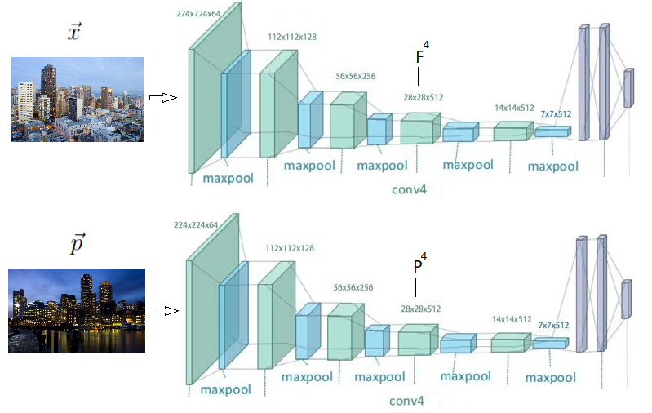
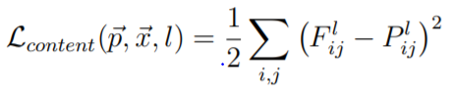
Content loss
Conv Layer 4 activations
(For layer l)

Slide 5
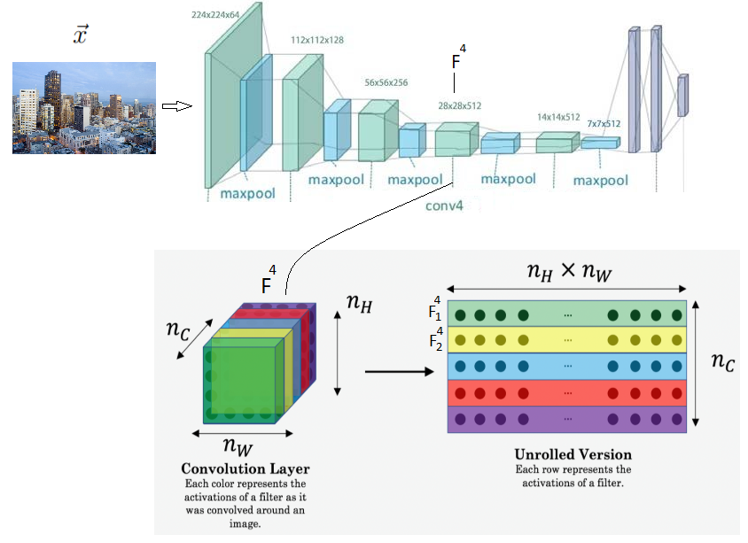
Style
Representation

Slide 6
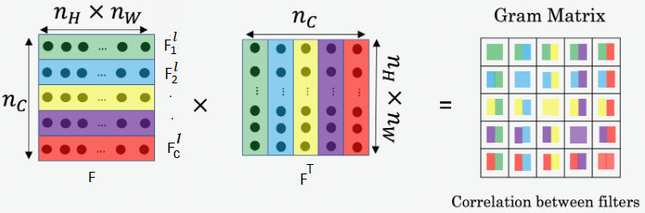
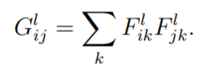
Style Representation
Correlation between channels i,j:

Slide 7
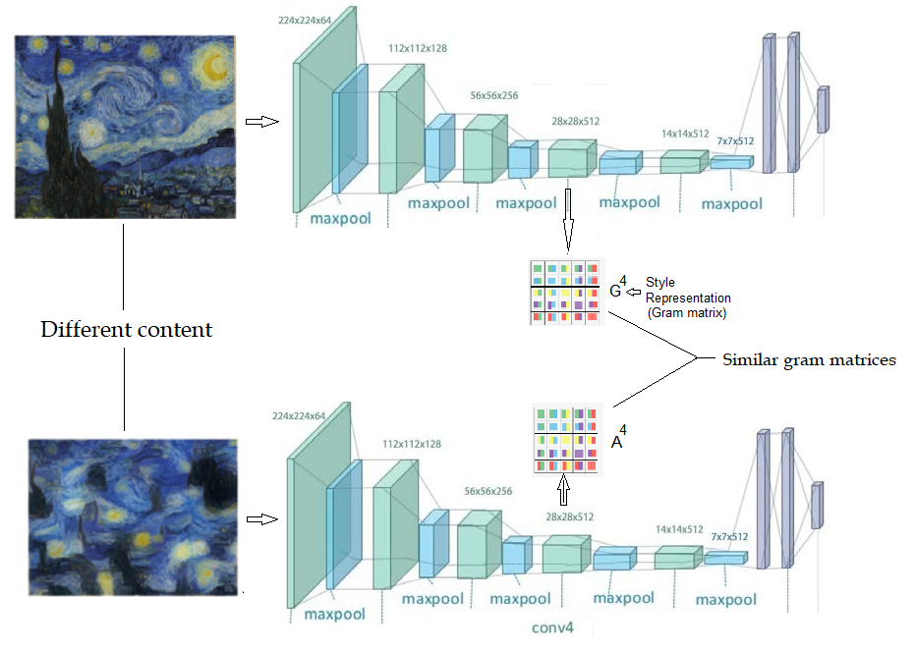
Style Representation

Slide 8
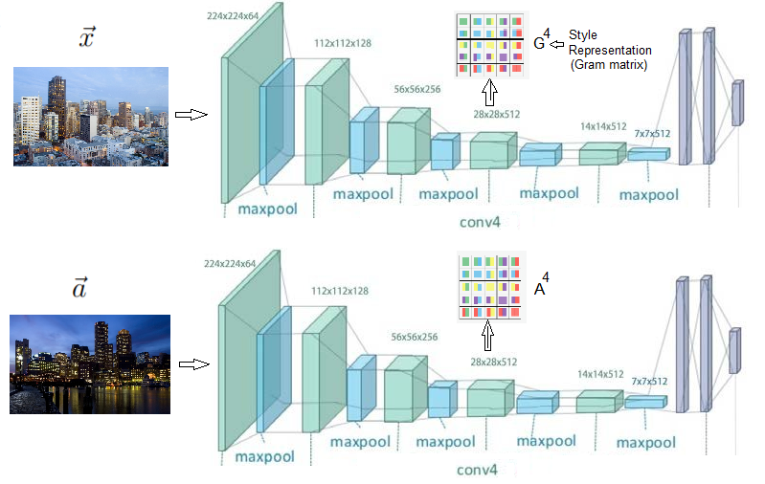
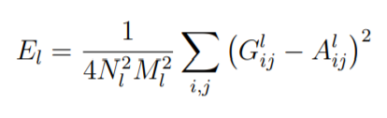
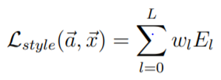
Style Loss

Slide 9
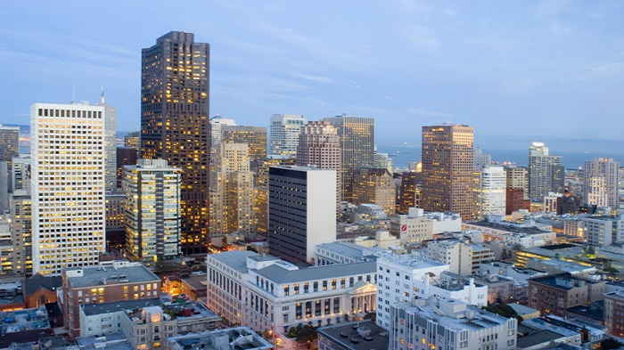
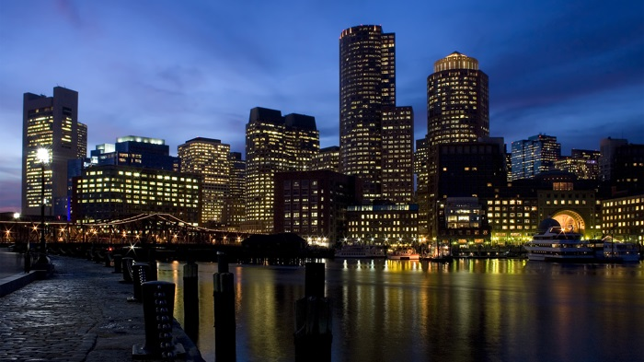
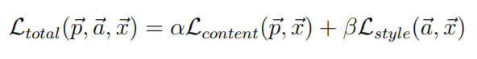
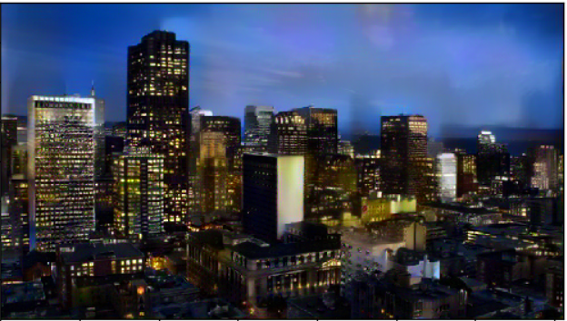
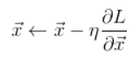
Overall loss
: content image
: style image
: generated image (initial value)
X can be initialized as random noise (we initialized it to be the same as P i.e. the content image)
Gradient descent changes X to minimize L
:after loss minimization

Slide 10
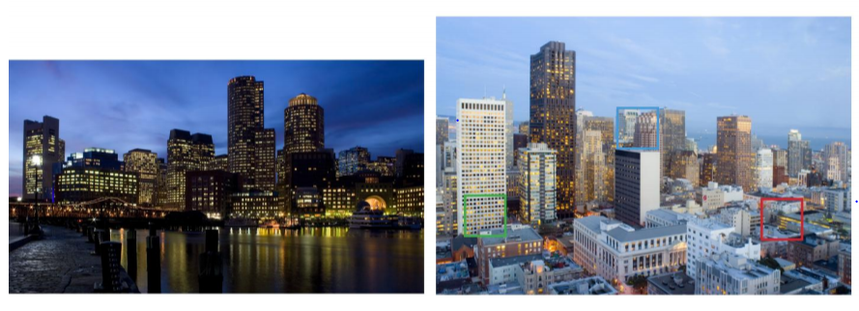
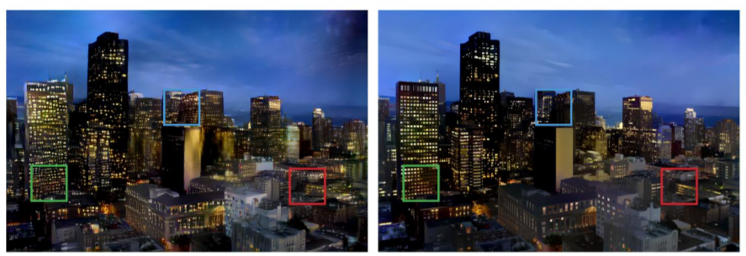
Enhancements
Style
Content
Output (distorted)
Output (after regularization)

Slide 11
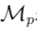
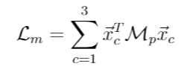
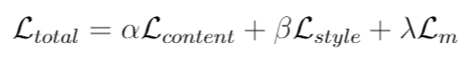
Enhancements:
Reducing distortion by adding regularization
: Matting laplacian matrix of content image p (described in Levin et. al)

Slide 12
Conclusion
The activations of an image in the VGG19 network represent it’s content
The gram matrix derived from these activations can be used to represent it’s style
Style transfer can be done by synthesizing an image that produces activations similar to the content image and produces a gram matrix similar to the style image

Slide 13
Thank you

